Slide 1
Jerome Lefebvre
Manager @ Aurecon within Asset Management Performance
This talk is inspired by work at Aurecon but not done as part of Aurecon
Last 10 years
Helping companies gain operational efficiencies using real-time data
GIS credentials:
Building them right now
https://github.com/JeromeLefebvre/DuckDB-Era5-Transmission
Today:
Measuring the impact of weather on the electricity grid (using DuckDB and Python)

Slide 2
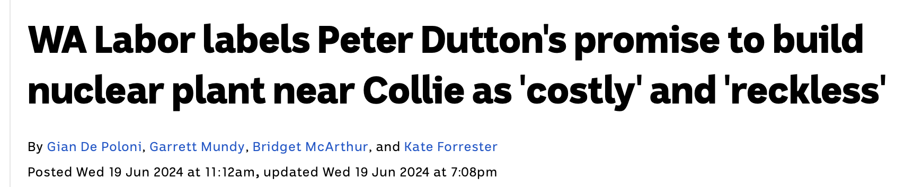

The WA energy future and the grid
WA Energy transmission:
Solar
Wind
Batteries
Lots of hope
Transmission lines are hard:
There is a backlog
Costly
Our favourite pastime is NIMBYsm

Slide 3
Real-time data usage @ Aurecon
Who I am:
Jerome, AMP, Perth
10 years of experience supporting, implementing real time data systems in OT
Use case:
Understand the weather impact on transmission lines
Tools:
DuckDB as an analytical tool available at Aurecon to help tackle such problems

Slide 4
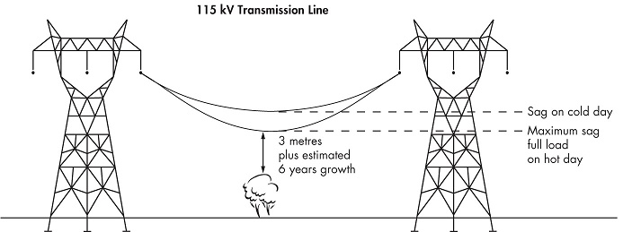
Weather's impact on transmission: SAG
Risk:
Fires
Trips
Safety
There is also a loss of operational efficiency as sag leads to less capacity of the grid

Slide 5
Thermal Capacity
Maximal Thermal Capacity
Net Current Carrying Capacity

Slide 6
Thermal Capacity
Heat Gain:
High ambient temp
Solar irradiance
Maximal Thermal Capacity
Net Current Carrying Capacity

Slide 7
Thermal Capacity
Heat Gain:
High ambient temp
Solar irradiance
Maximal Thermal Capacity
Net Current Carrying Capacity
Heat Loss:
Low ambient temp
Wind

Slide 8
Thermal Capacity
Heat Gain:
High ambient temp
Solar irradiance
Maximal Thermal Capacity
Net Current Carrying Capacity
Heat Loss:
Low ambient temp
Wind
Static Rating
Potential Capacity

Slide 9
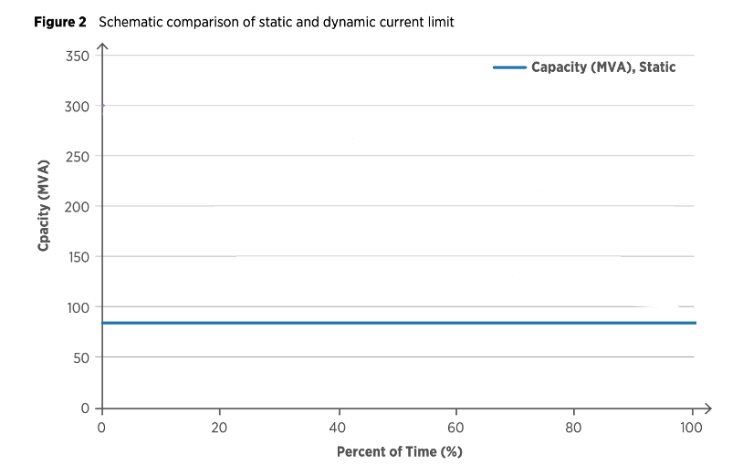

Slide 10
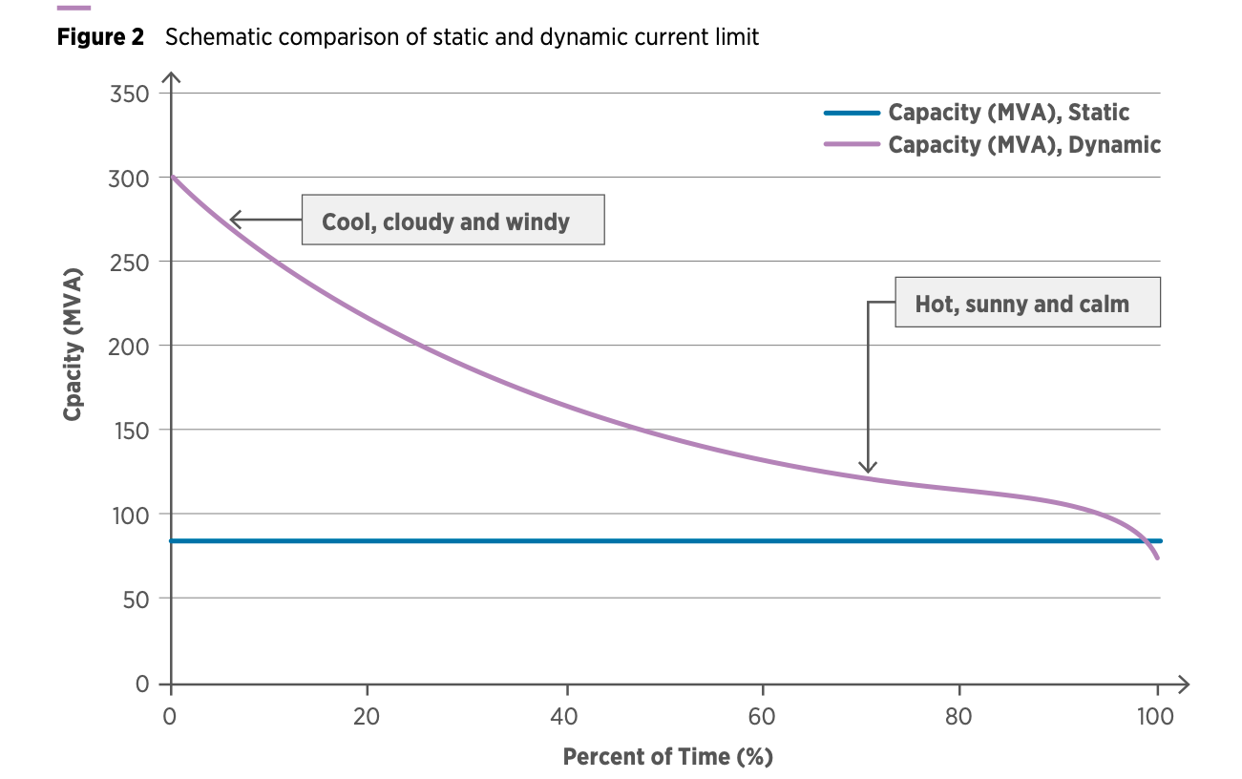
Loss opportunity!
Static Capacity

Slide 11

Approach: Attach sensors all over the place

Slide 12

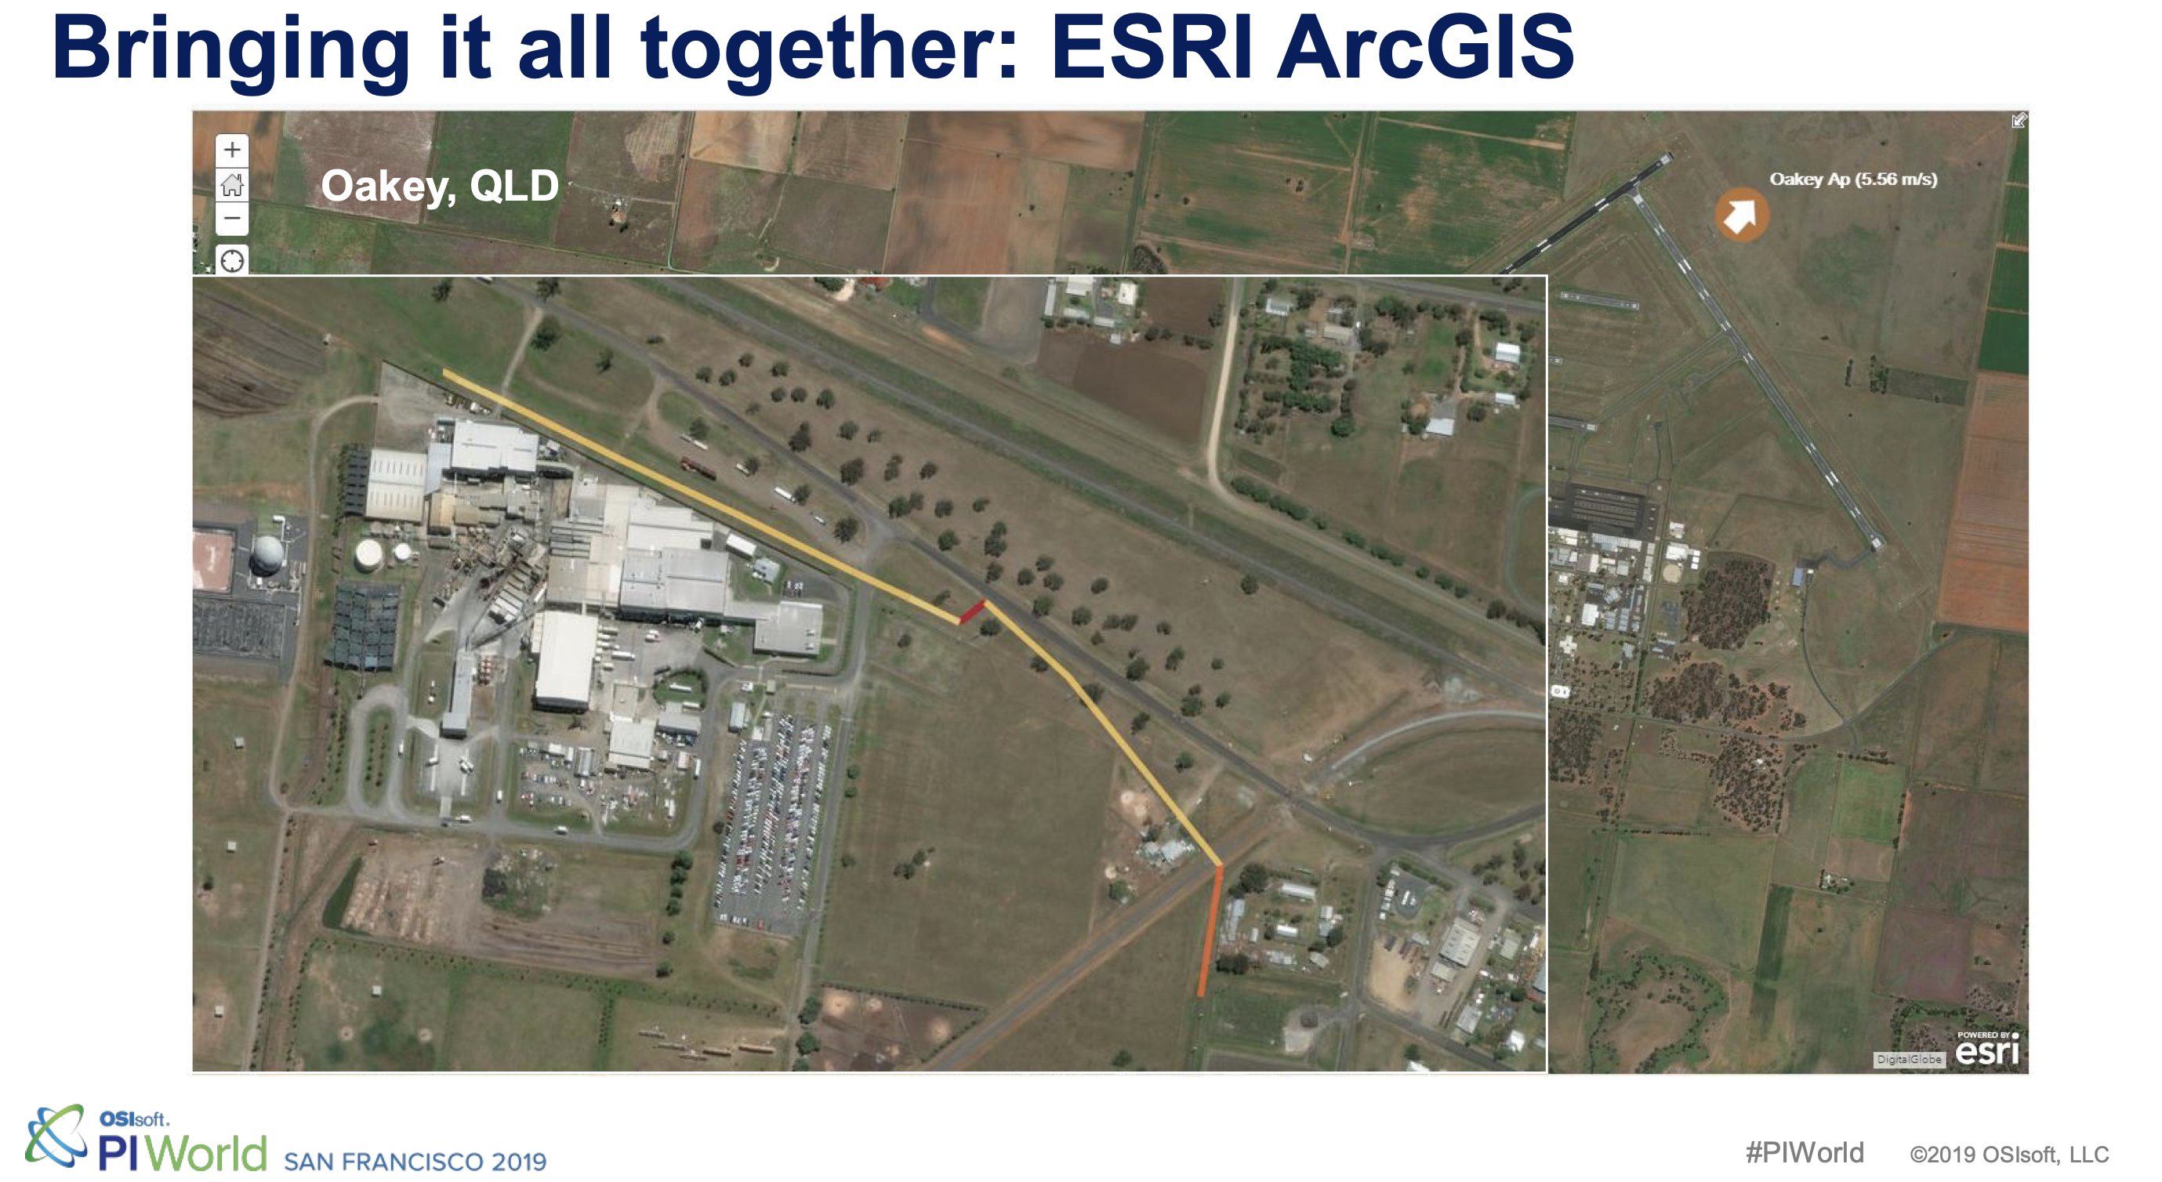
Approach: Simulate the weather loss

Slide 13
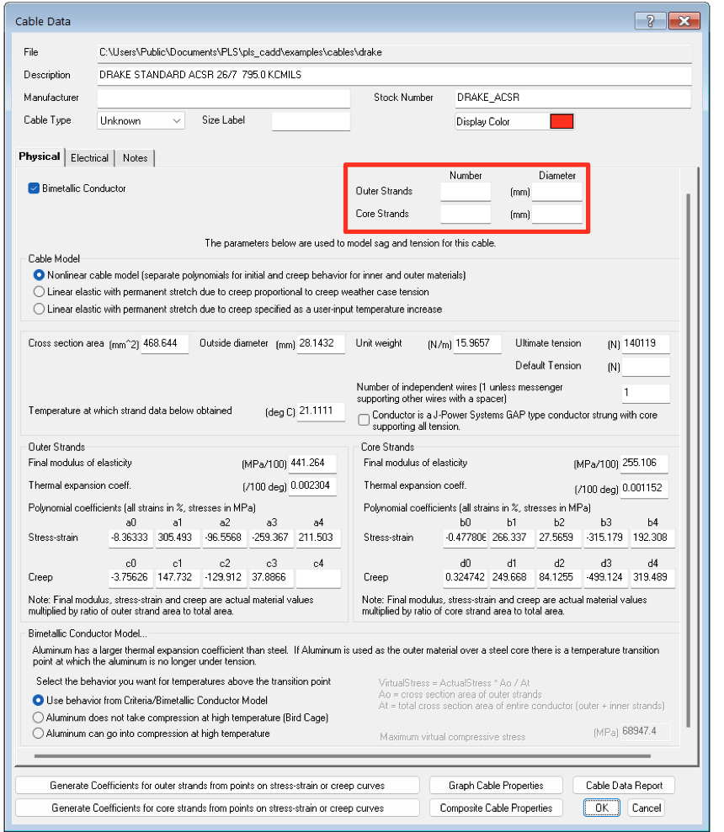
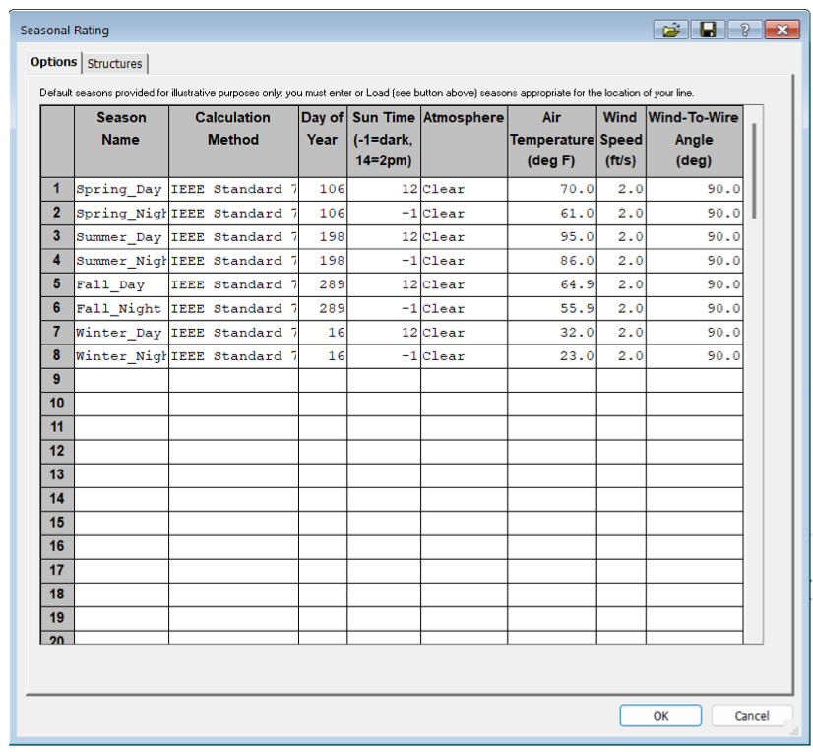
Notes:
https://www.powline.com/technotes/ThermalRating.pdf

Slide 14








$$$
A fair fight!

Slide 15
Needs Three ingredients
Calculating the impact of weather on transmission lines
Transmissions lines
Weather Data

Slide 16
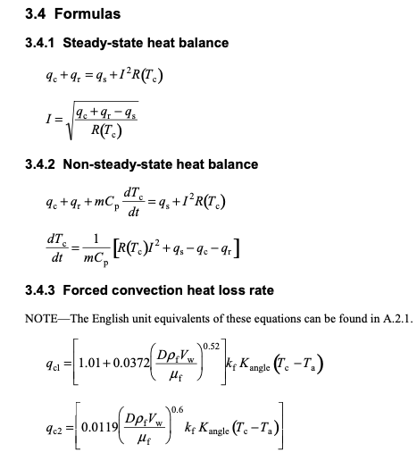

Calculations

Slide 17
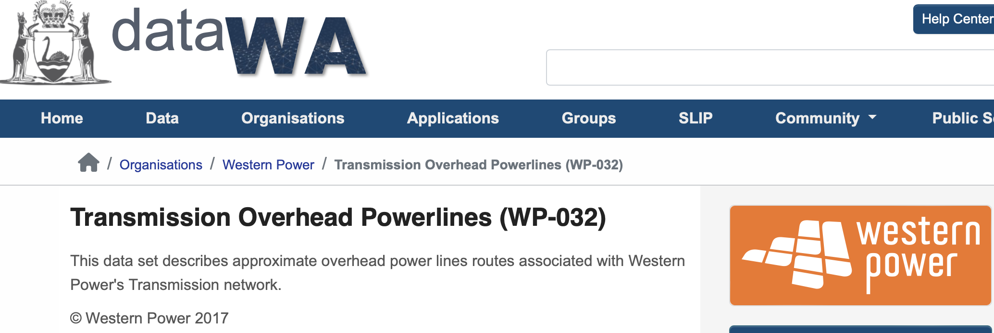
The transmission data
Geospatial data
Capacity
Name

Slide 18
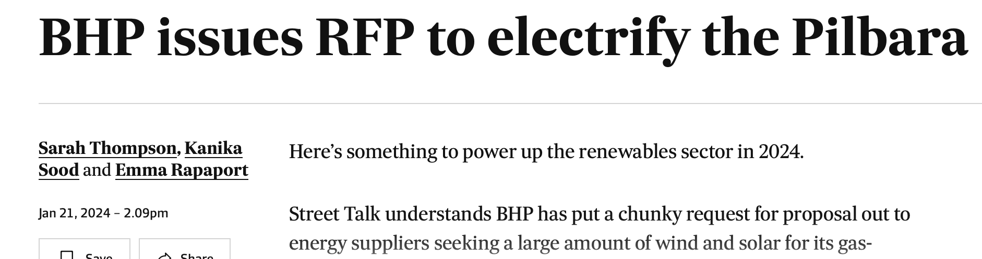
Where will new lines be built?

Slide 19
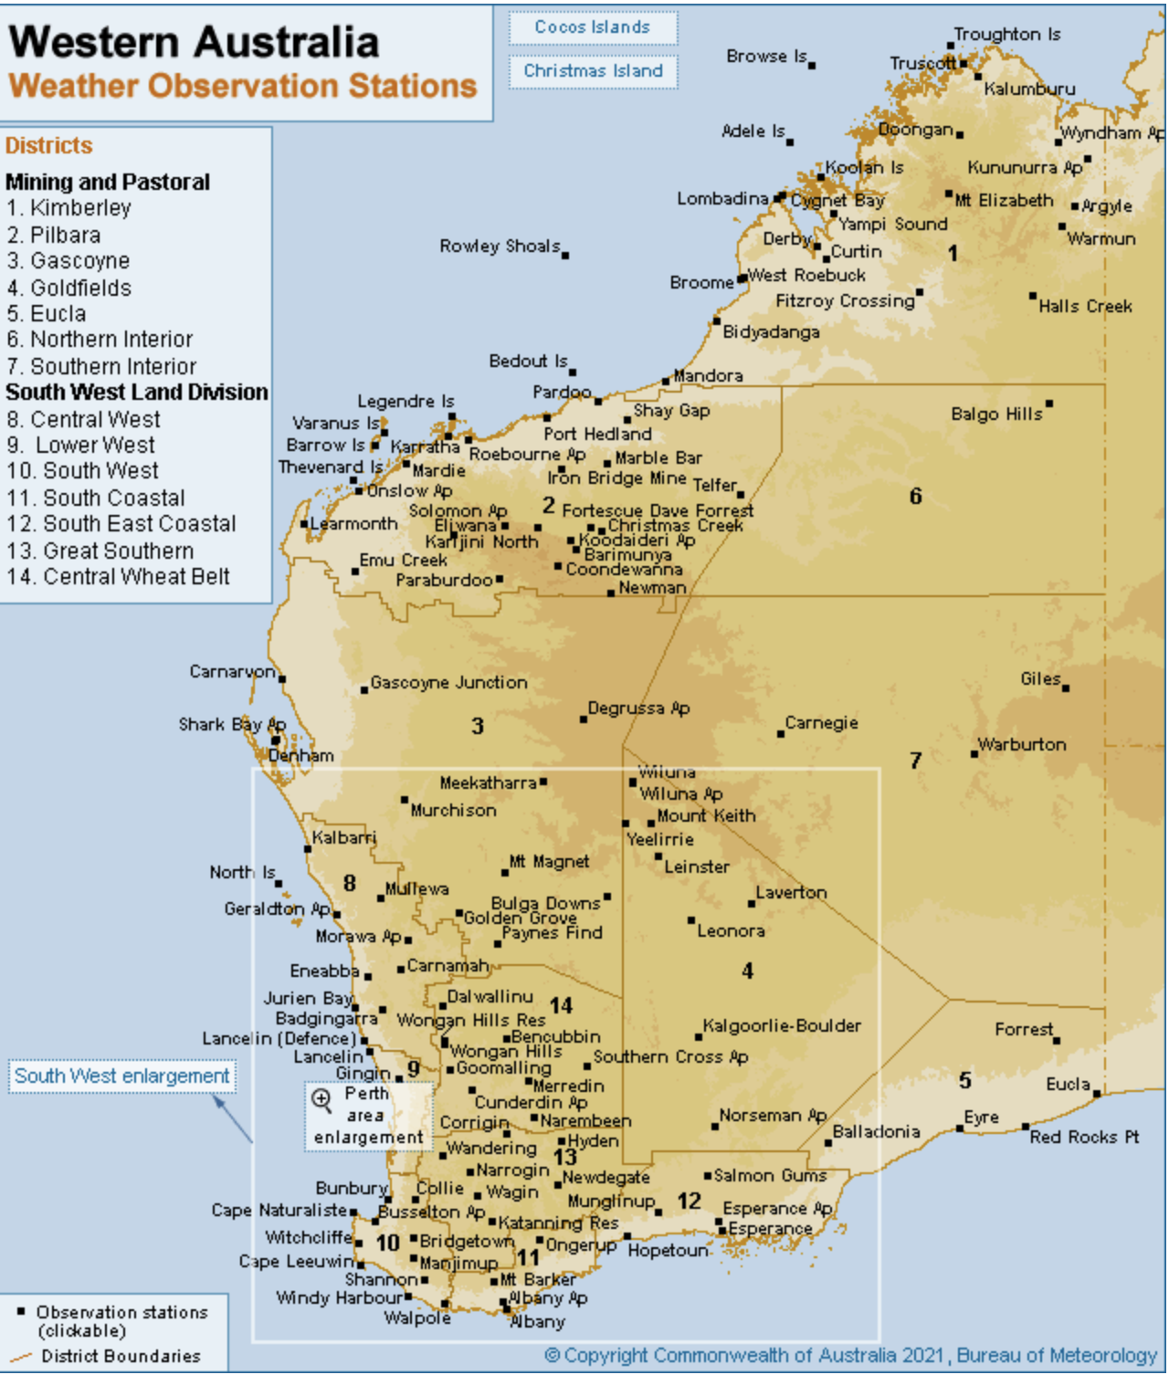
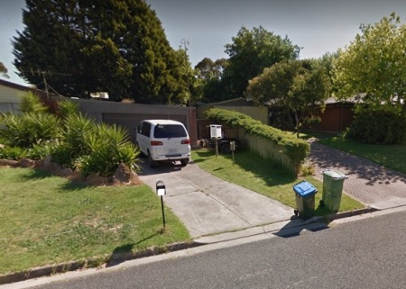
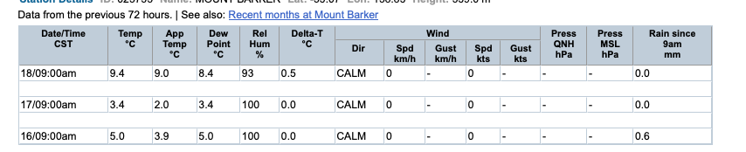
What is BOM Data

Slide 20
What is BOM Data

Slide 21
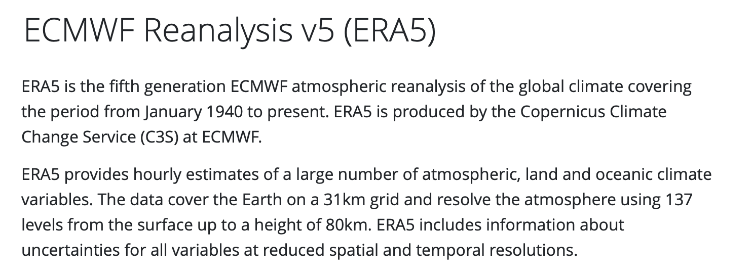
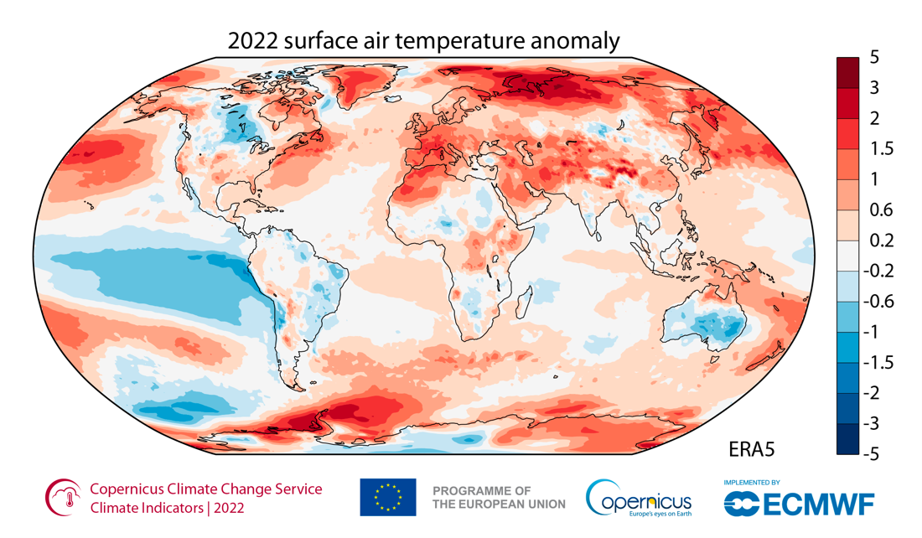
Let’s use simulated weather data
Add image

Slide 22

Weather average
Year: 200*, month: January
8am
8am
Average weather at 8am
On a January
8am
8am
8am

Slide 23
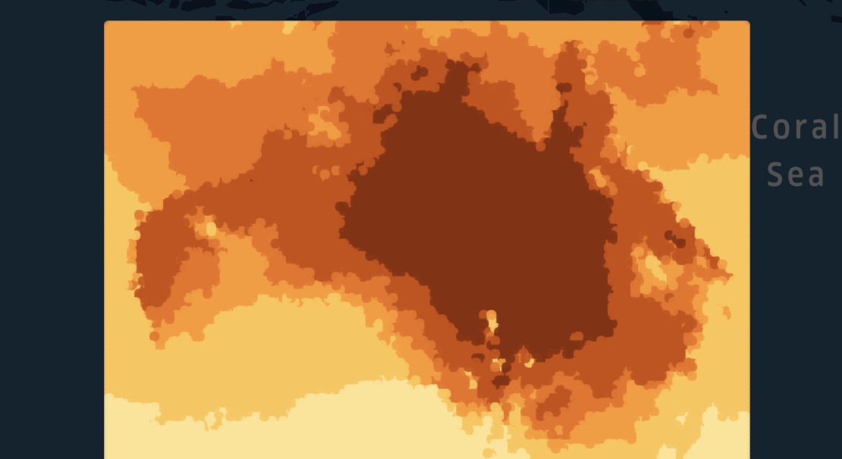
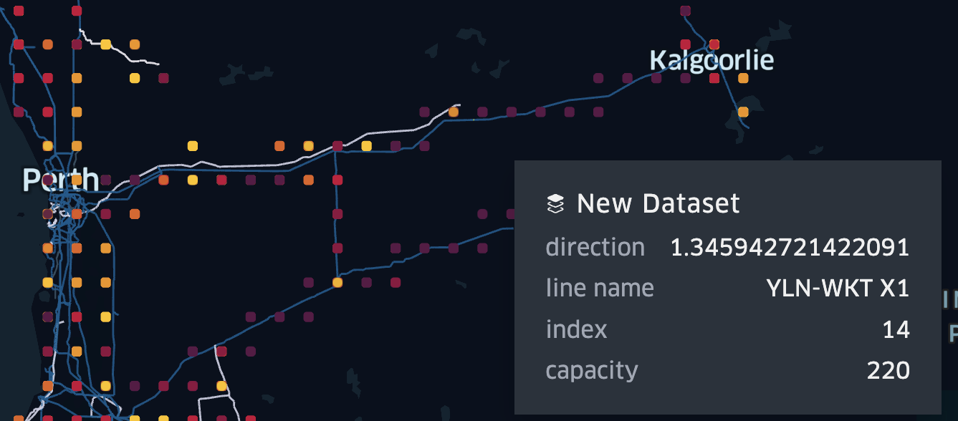
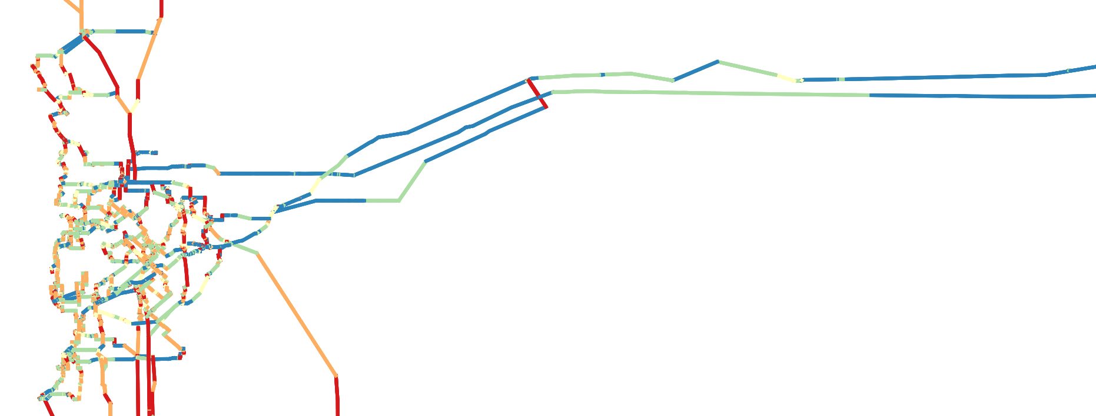
Queries
# 2 Apply some averages the to weather
#1 Split the Western Power Grid into segment, add foreign keys
#4 Add in IEEE738 Calculations (python)
#3 Joining the data set
#5, #6, #7, …
Average 8 am in June-July power efficiency gain?
Should we ask this battery to only discharge at 5 pm?
Part of the grid most impacted by the extreme weather?

Slide 24




Data Flow
Inputs
Query#1
Calculate averages
Query#3
Join the inputs
Query#4
Apply model
Query #5, #6, #7
What about this?
What about that?
Era5 or BOM Weather
.csv, .parquet, .json
Query#2 Decompose into spans
DuckDB
Scripting
Power BI/Excel,
QGIS, Grafana, qStudio
Merge
Enrich
Visualise
Western Power Transmission.shp

Slide 25

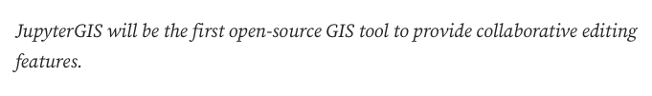
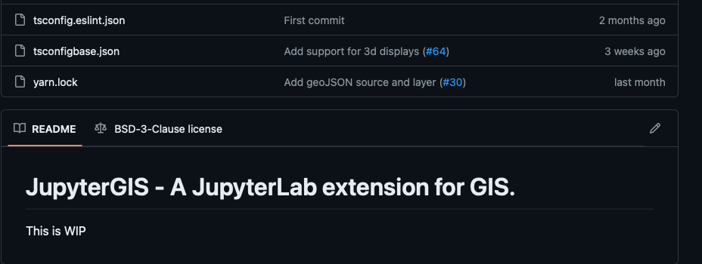

Slide 26
Other use cases
Run cloud work back on local machine
Clean-up data sets
ETL (data pipe)
Geospatial analyses
Reports on flat data
Ad-hoc queries on large data set

Slide 27
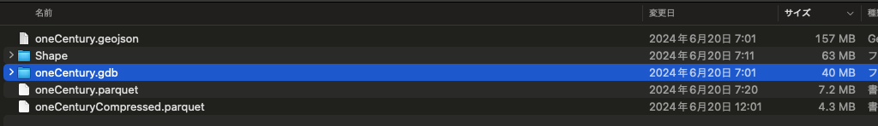
Compare sizes

